Slide 1
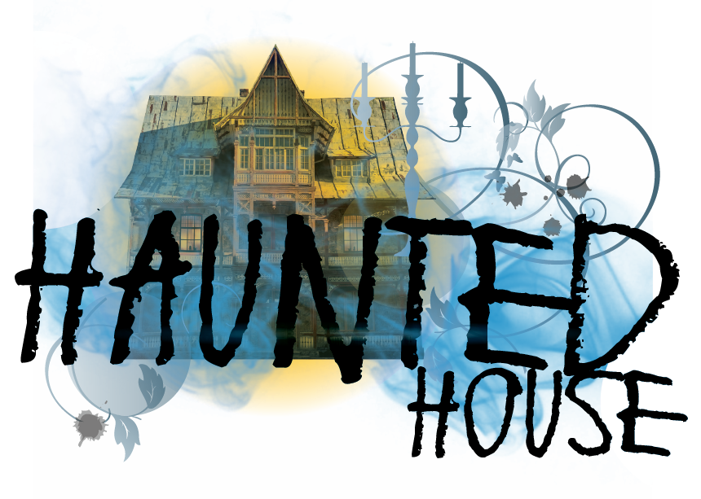
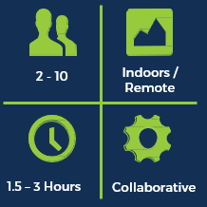
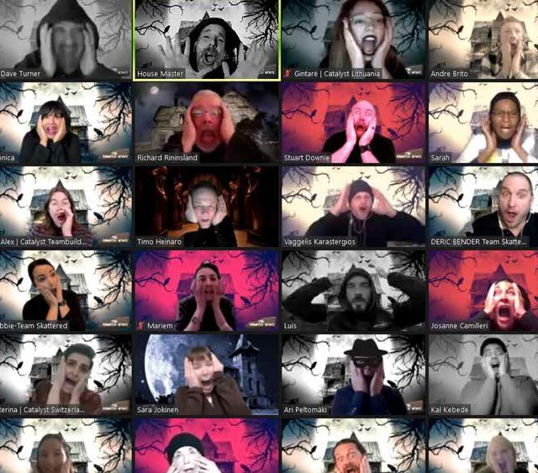
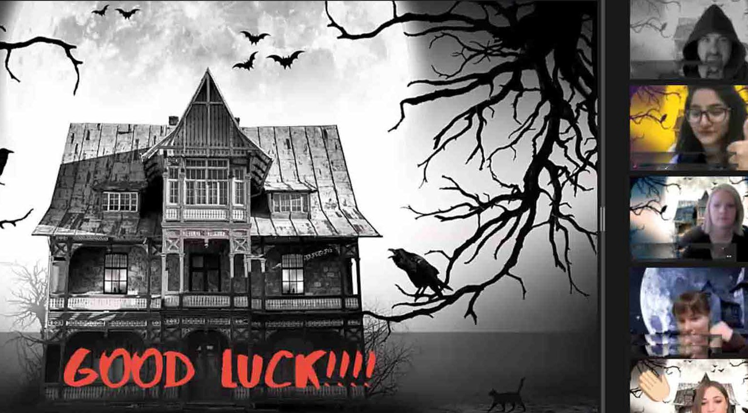
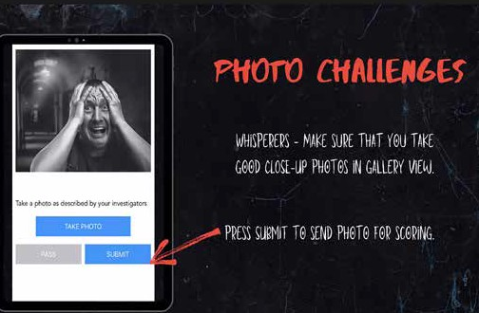
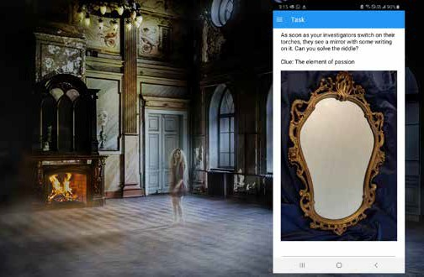
Haunted House
4 - unlimited
A virtual team building game full of engaging escape room challenges, specifically designed to enhance remote team work.
1.5 – 2 Hours
Competitive / Collaborative
How It Works
Learning Outcomes
Key Business Benefits
Teams of four or five people compete against
each other, solving cryptic clues and completing hilarious photo challenges to be the first to escape the virtual haunted house. Playable on any mobile device in any location via our award-winning Go Team app, each team selects a player to be their ‘Ghost Whisperer’. The rest of the team, or ‘Investigators’, must guide their Whisperer to solve the clues – and complete three ghoulish mental and creative challenges – to escape each of the rooms in the house. Your teams have just 90 minutes to work together to escape all six rooms in the haunted house – and the one with the most points that breaks the final code, wins!
Haunted House has been specifically designed around developing an attitude of courage in a team. The gameplay drives teams to work together valuing and celebrating each person’s ideas, actively listening and nurture discussion. As team trust builds, participants learn to shrug off a fear of failure, take courage to speak up and communicate their ideas with clarity. Through trust, self-belief and courage teams discover the successes that collaborative deductive reasoning can bring. The infectious and fun escape room style challenges and engaging theme bring a fresh perspective to working as a team. By gamifying the critical components of courageous teamwork, Haunted House will be a reflective experience for teams.
Exploring team dynamics Effective Communication Collaborative decision making Creative thinking

