Slide 1
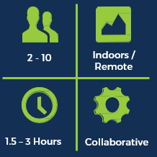
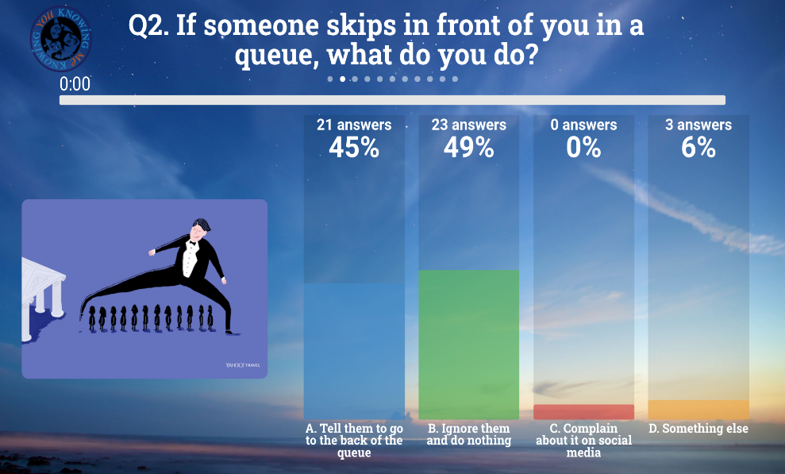
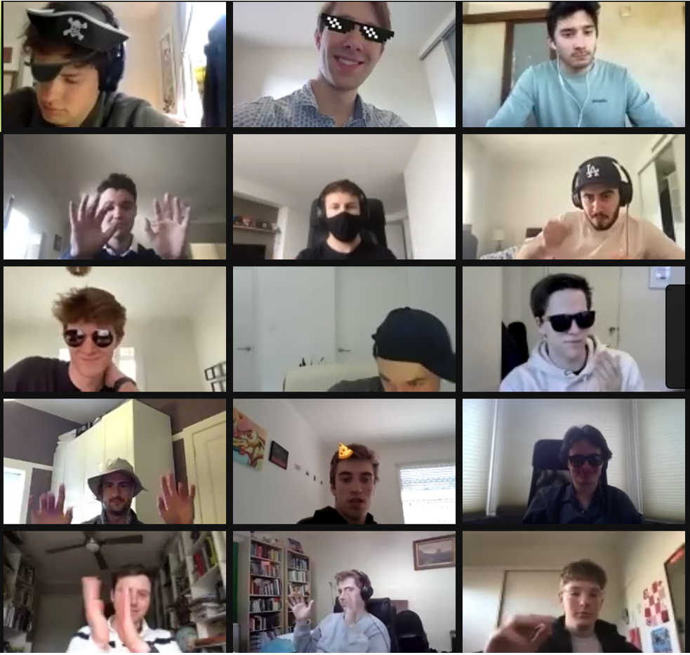
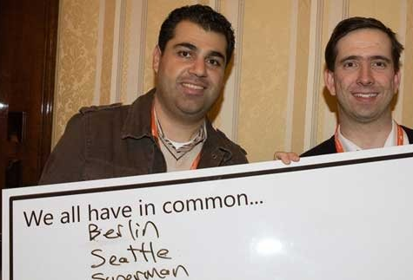
Knowing Me Knowing You - Virtual
12 - unlimited
Indoors / Remote
A fun ice-breaker where individuals race to discover commonalities between themselves and others to win points.
30 – 60 Minutes
Competitive
How It Works
Learning Outcomes
Key Business Benefits
The activity begins with a warm-up exercise on the video conferencing tool of your choice. During the game individuals are tasked with gathering as many commonalities with other players as they can. Participants will observe how they and others navigate simple real life situations in a jovial group discussion before the fast paced and competitive task of making as many individual connections as they can by being thrust in and out of breakout rooms. The fun and non-judgmental structure keep the energy buzzing and the competition high as you work to find the groups commonality winner.
Relationships matter, and a highly connected workforce is a valuable asset to any organisation. Knowing Me Knowing You helps to build common ground between individuals, smoothing the path for information sharing and best practice that will inevitably lead to improved bottom line results
Fun & motivation Negotiating skills Networking Uniting teams

